Slide 1
Ventura County Fire Department Incident data

Slide 2
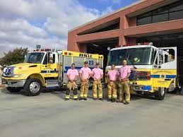
Team Members
Rafael Cordero
William Hollingsworth
Woobae Kim
Vamsi Kiran Reddy Muddam Shankar

Slide 3

REQUIRED TASKS
Extract data from .csv file in Java without using any third-party library
Normalize the data by cleaning out empty/redundant rows
Remove data not needed when using RegEx
Remove outliers – Long random data and empty rows
Add period in longitude and latitude.
Make sense of data by applying functions and tools.

Slide 4

DELIVERABLES
Graph total incident call for each category - Fire, Medical, FireBrush, Traffic collision.
Calculate average response time per category
Map the area of incidents – convert Latitude and Longitude to plot points

Slide 5
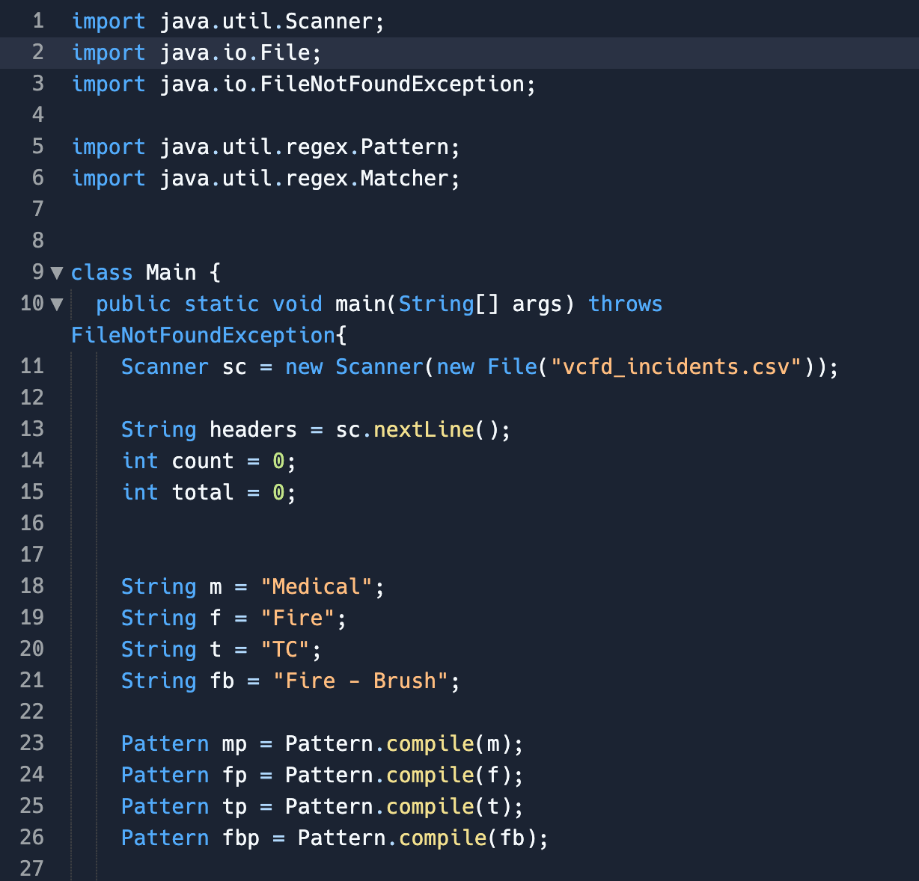
Calculating Average Response Time per Category
First 3 lines to read the files
5th & 6th to do RegEx matching
Start by opening the Scanner to the csv file
First line of the csv file is the headers
Count of how many records there are & total response time
Each of the key words we look for in that column that tells what the type of event was
Going to be either “Medical”, “Fire”, “TC”, or “Fire - Brush”
Take each of thse Strings and compile them into patterns
Once compiled, can determine whether or not that particular pattern matches a string

Slide 6
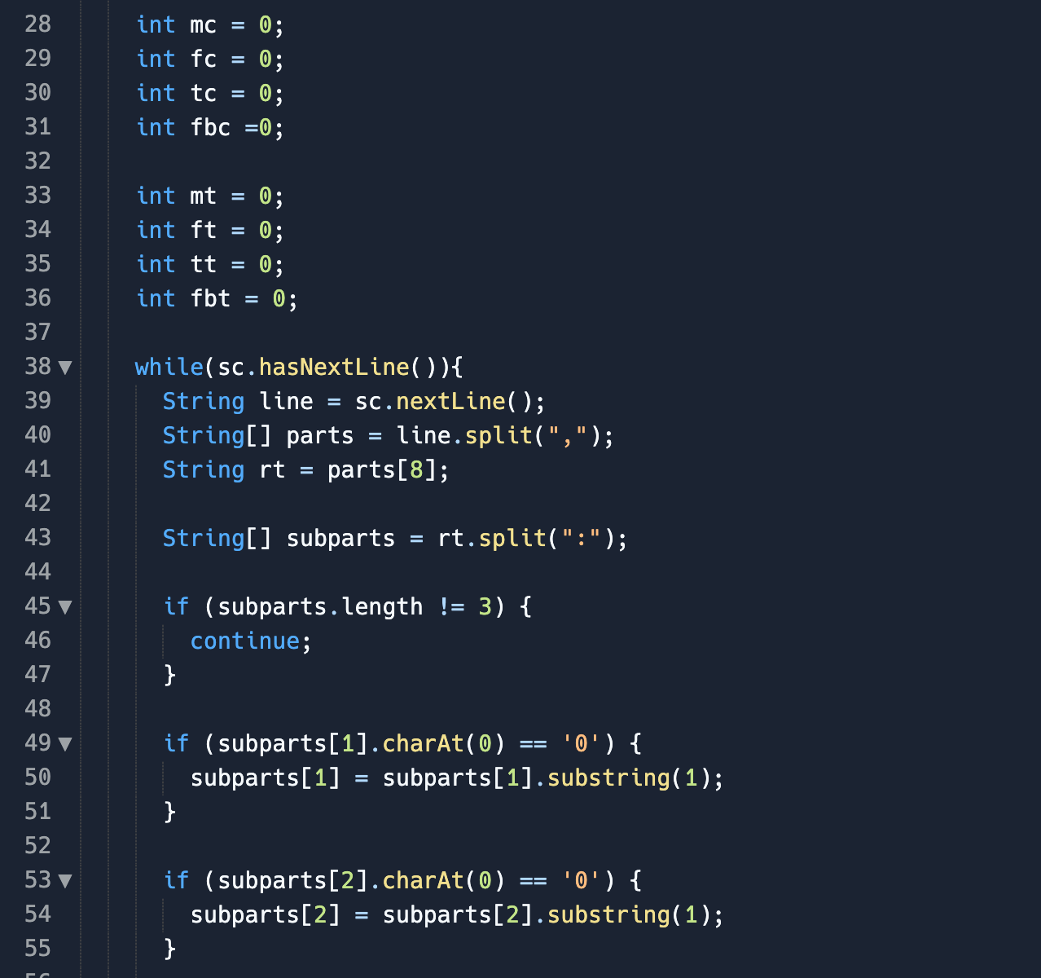
Calculating Average Response Time per Category
Count for number of events of each kind and total response time
As we encounter events, we add to the counter and time
So long as there are lines left in the csv, we will read a line out of the file
Split in on the coma
Split the file into an array of parts
Response time (rt) will be in the form of 0:03:27
Split in by the colon to get 3 strings: “0”, “03”, “27”
If no 3 parts, won’t use
If first character of mins is 0, want to skip it
“03” -> “3”
Same thing with seconds

Slide 7
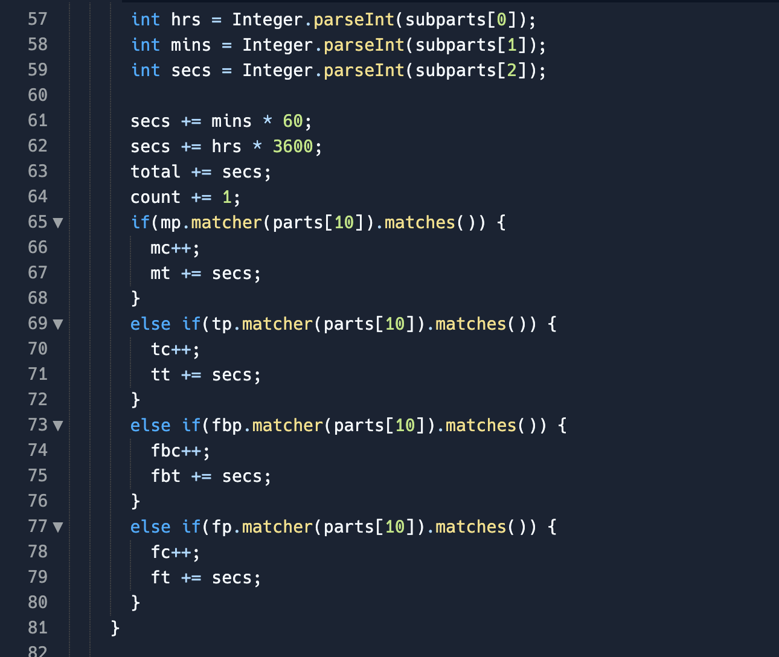
Calculating Average Response Time per Category
Take those parts and parse each into integers (hrs, mins, secs)
I want this all in seconds
Add minutes * 60 & hrs * 3,600 each to seconds
Add secs to the grand total as well as 1 to the count and then use RegEx matcher
If medical pattern matches parts[10] then 11th column is the word “medical”, if so, the “medical” count goes up by 1 and “medical” total time goes up by however many seconds
Else ifs are important = both “fire” and “fire - brush” have the word “fire” in them so we have to check for “fire brush” first

Slide 8
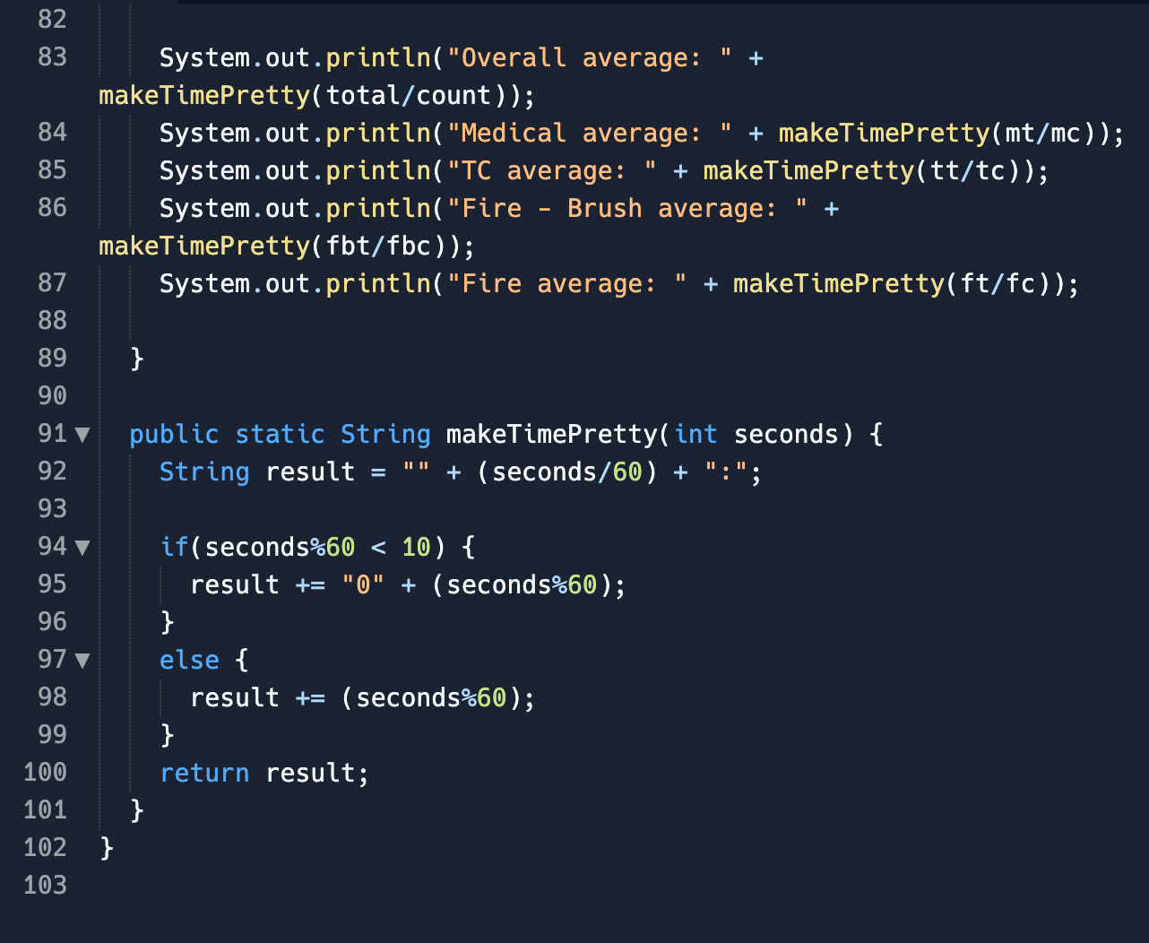
Calculating Average Response Time per Category
We have number of each kind of event + total time (so we can find average)
Pass each of them into the makeTimePretty function
Takes in seconds and turn it into mins:sec format

Slide 9
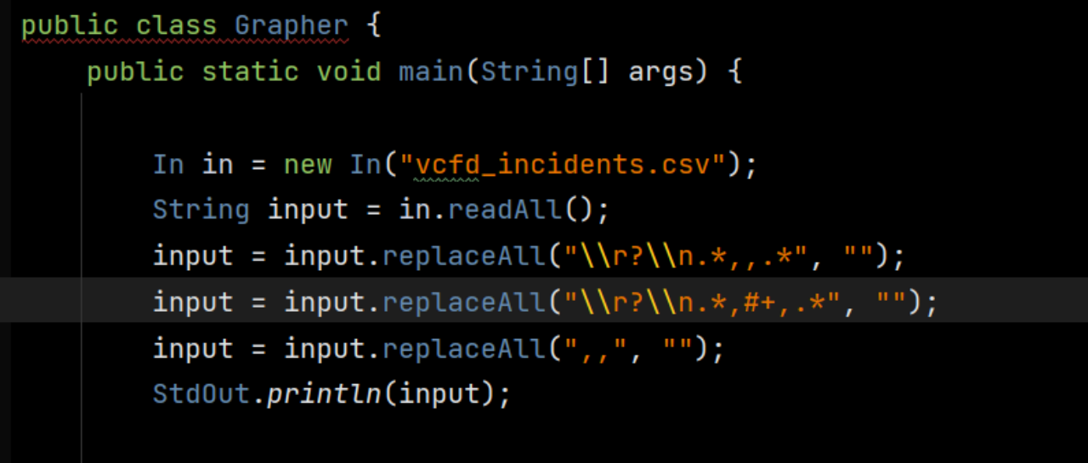
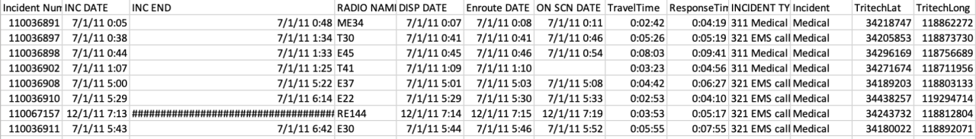
REGEX CODING - COLLATION

Slide 10
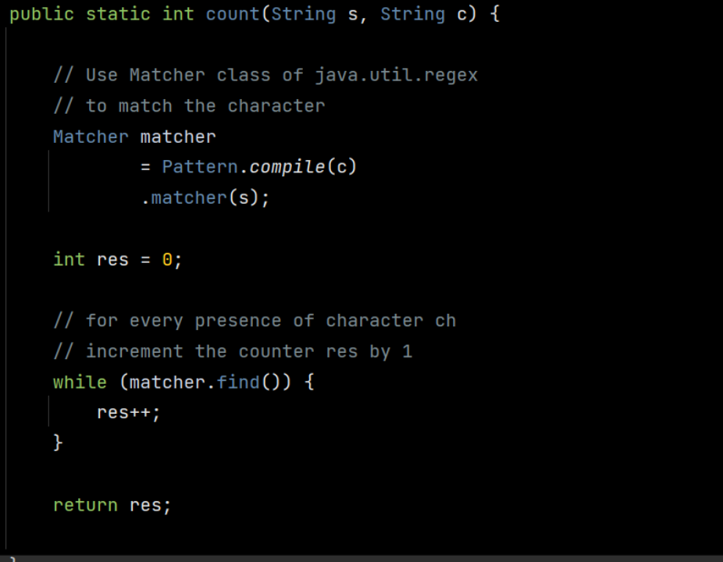
REGEX CODING - COLLATION

Slide 11
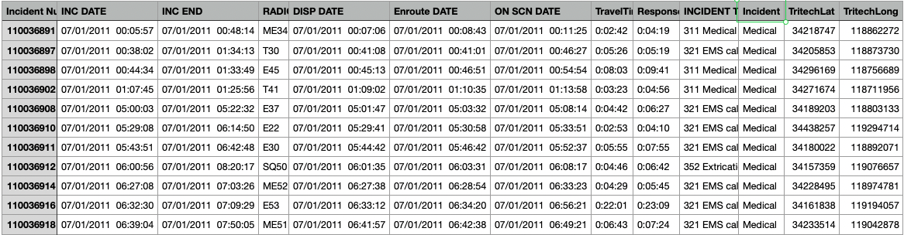
Extracting/Normalizing
Latitude & Longitude
Using LatLon.java
Cordero

Slide 12

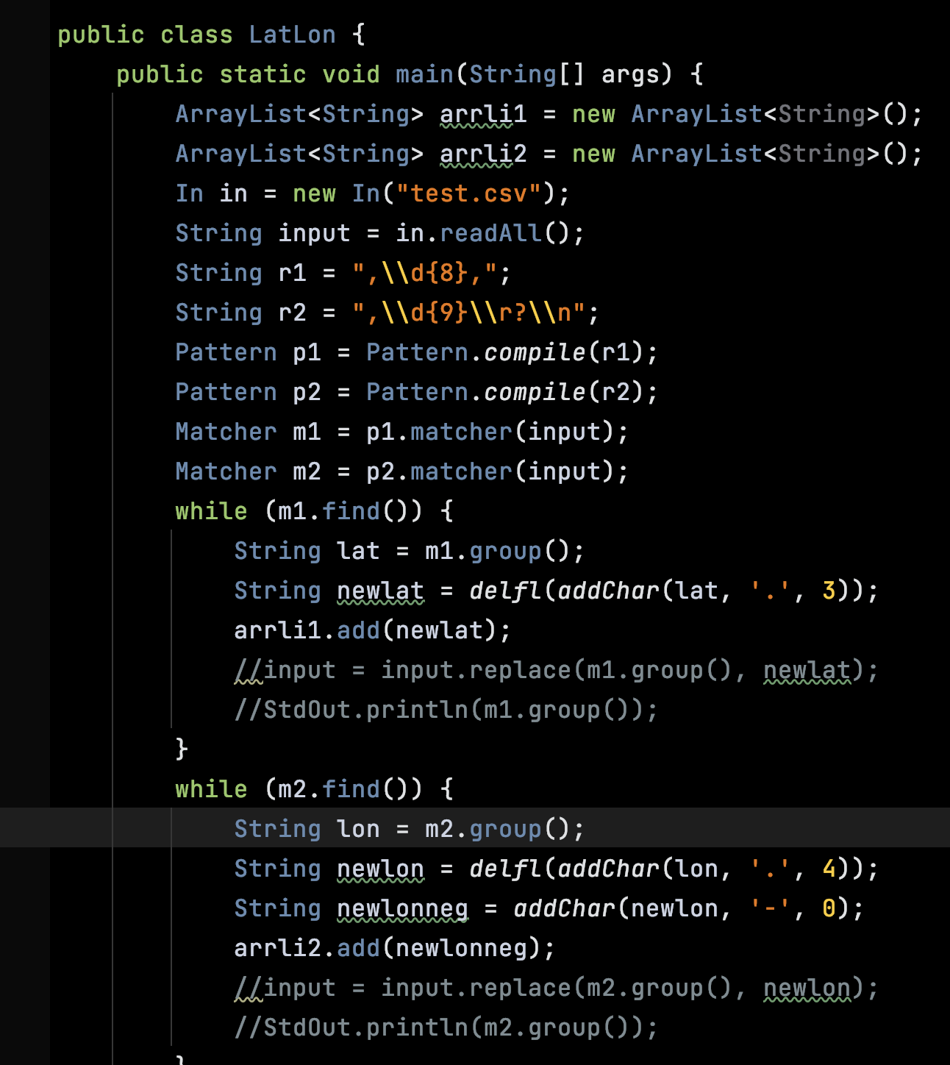
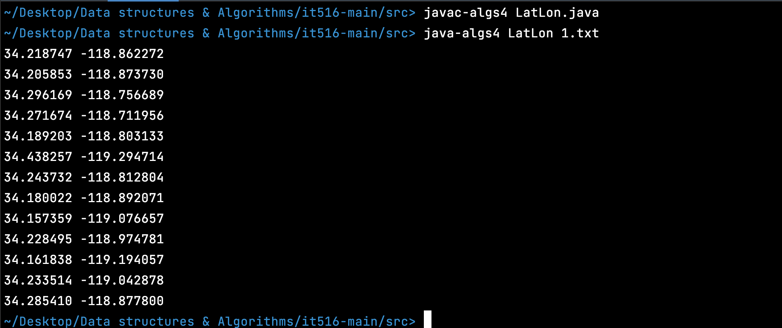
Test.csv
1.txt
Page 1
.
.
.

Slide 13
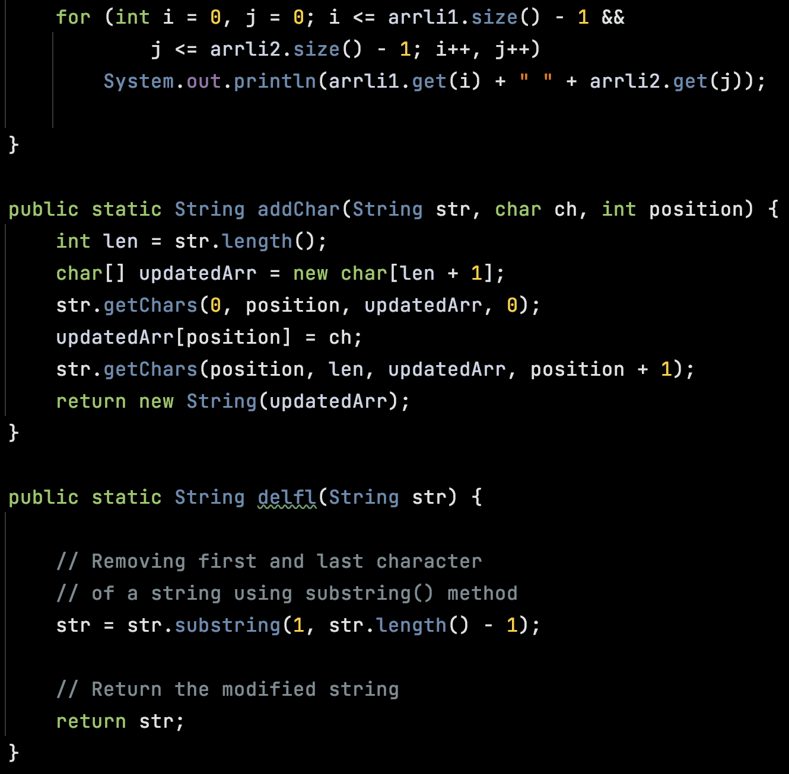
Test.csv
1.txt
Page 2
.
.
.

Slide 14
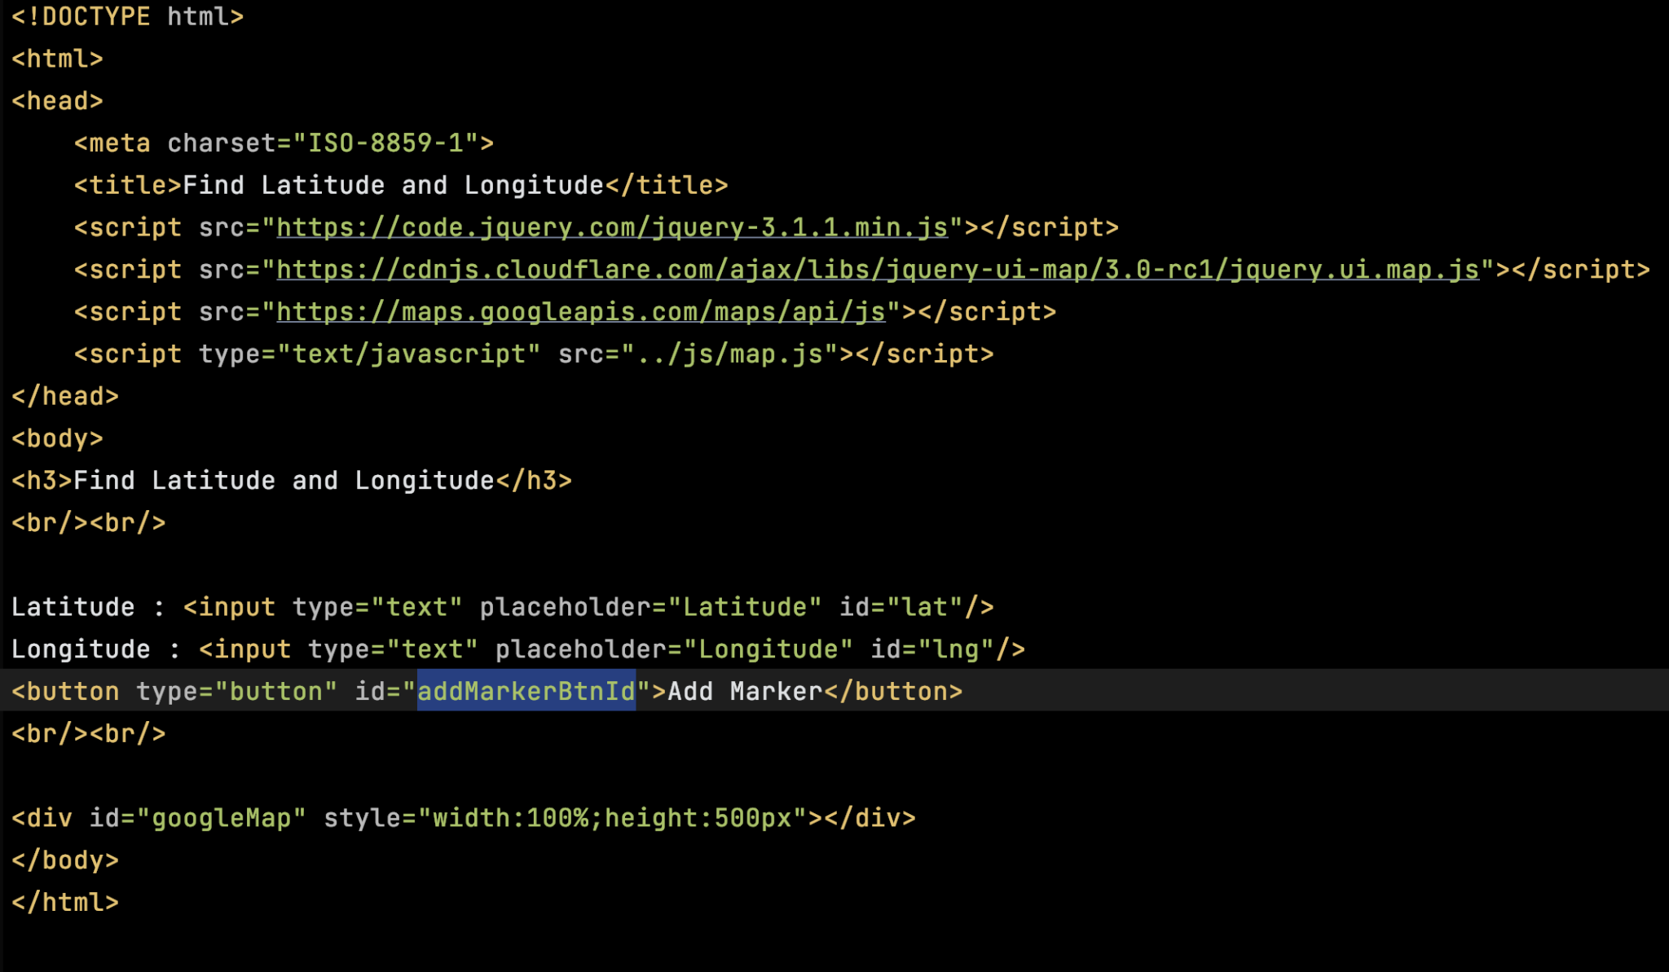
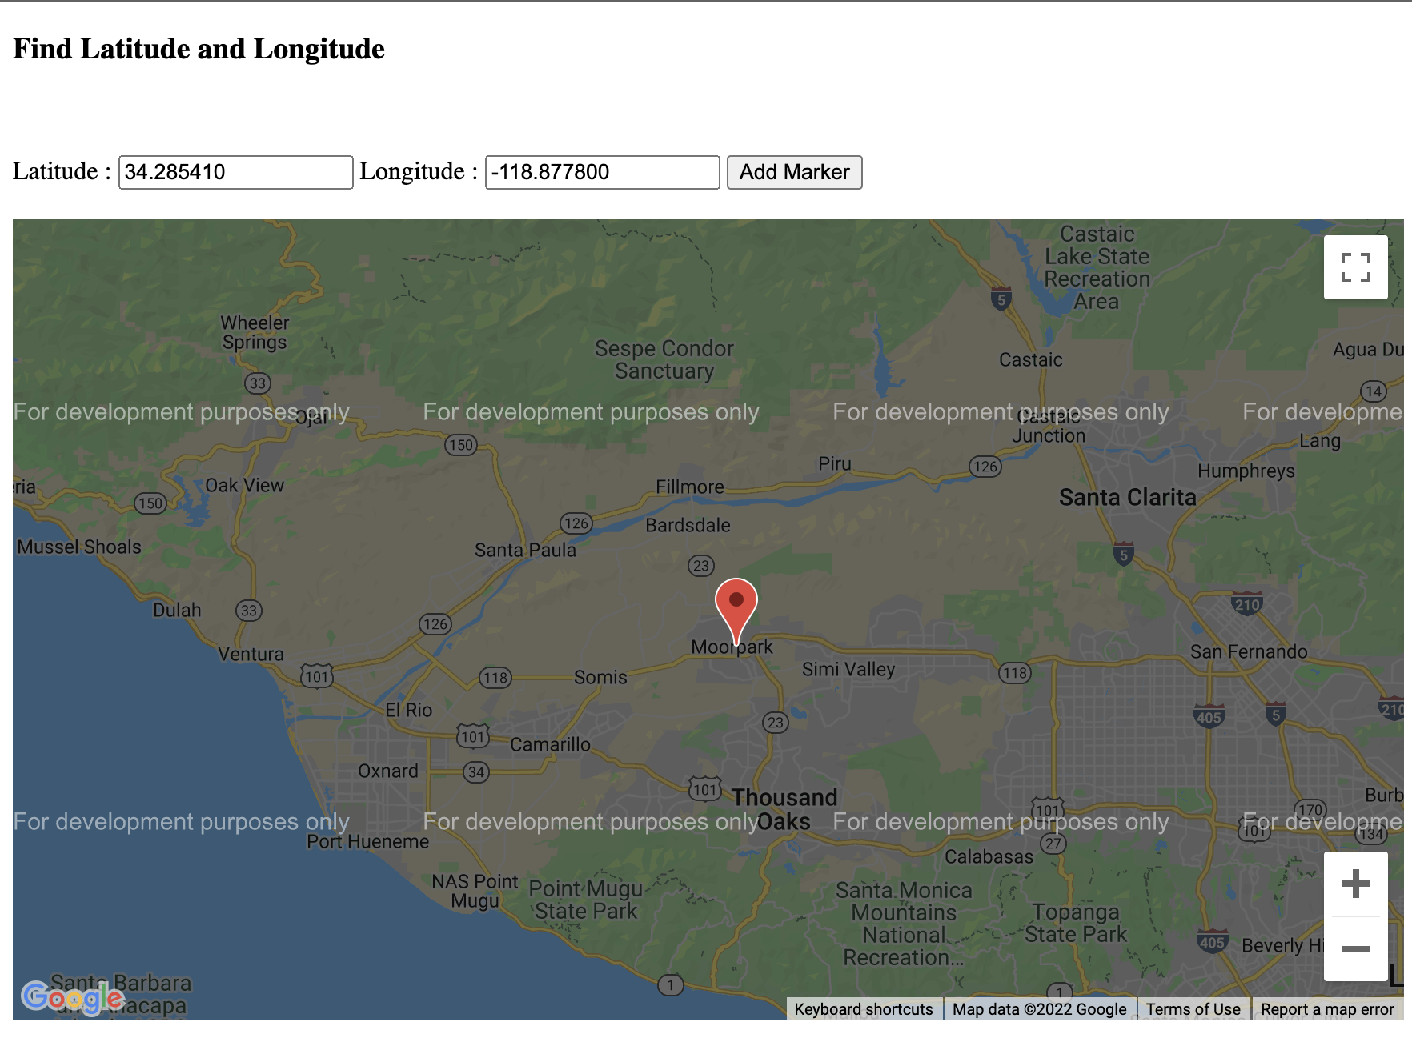
Creating a Map with HTML and JS
.
.
.
We declare the application as HTML5 using the <!DOCTYPE html> declaration.
We create a div element named "googleMap" to hold the map.
We define a JavaScript function that creates a map in the div.
We load the Maps JavaScript API using a script tag.
.
.

Slide 15
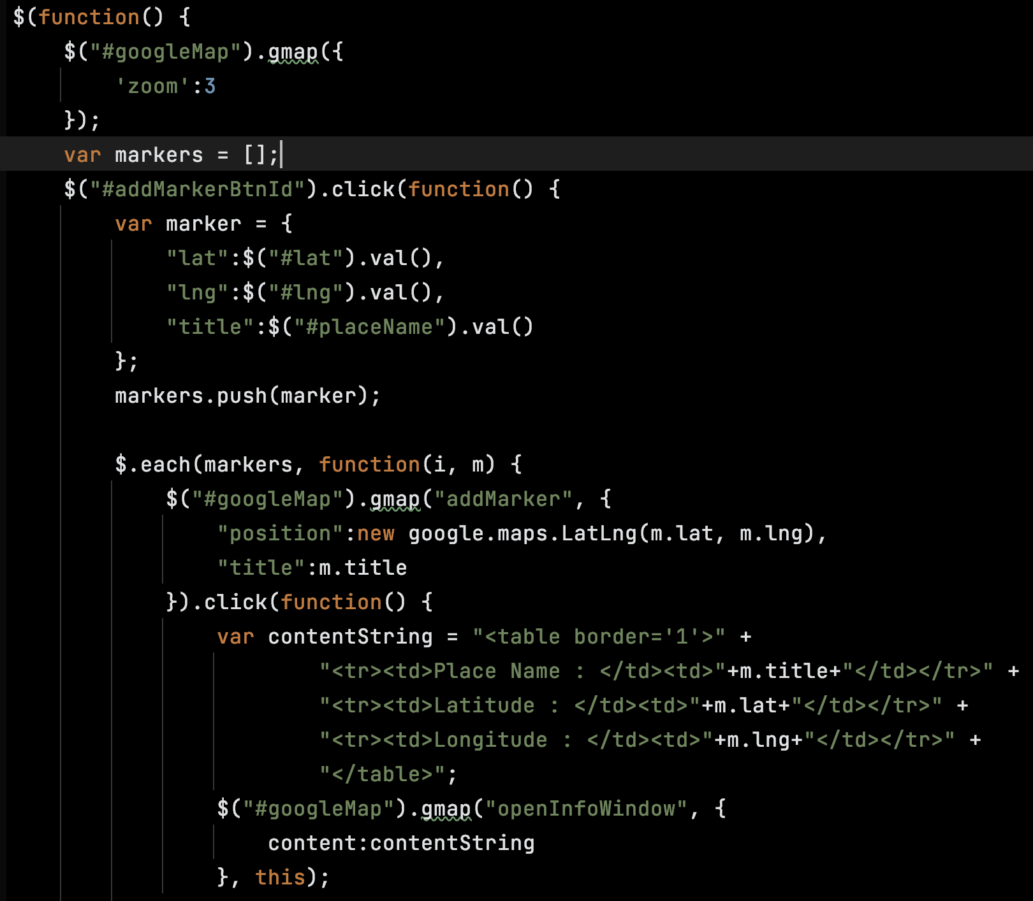
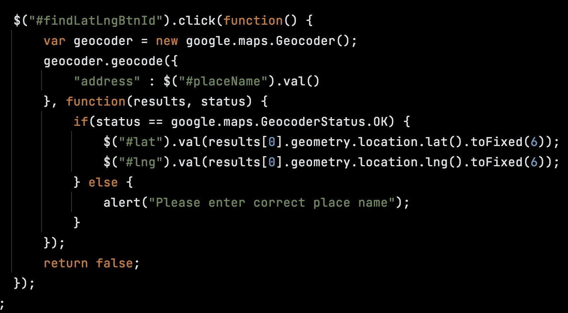
Creating a Map with HTML and JS
.
.
.
.
.

Slide 16
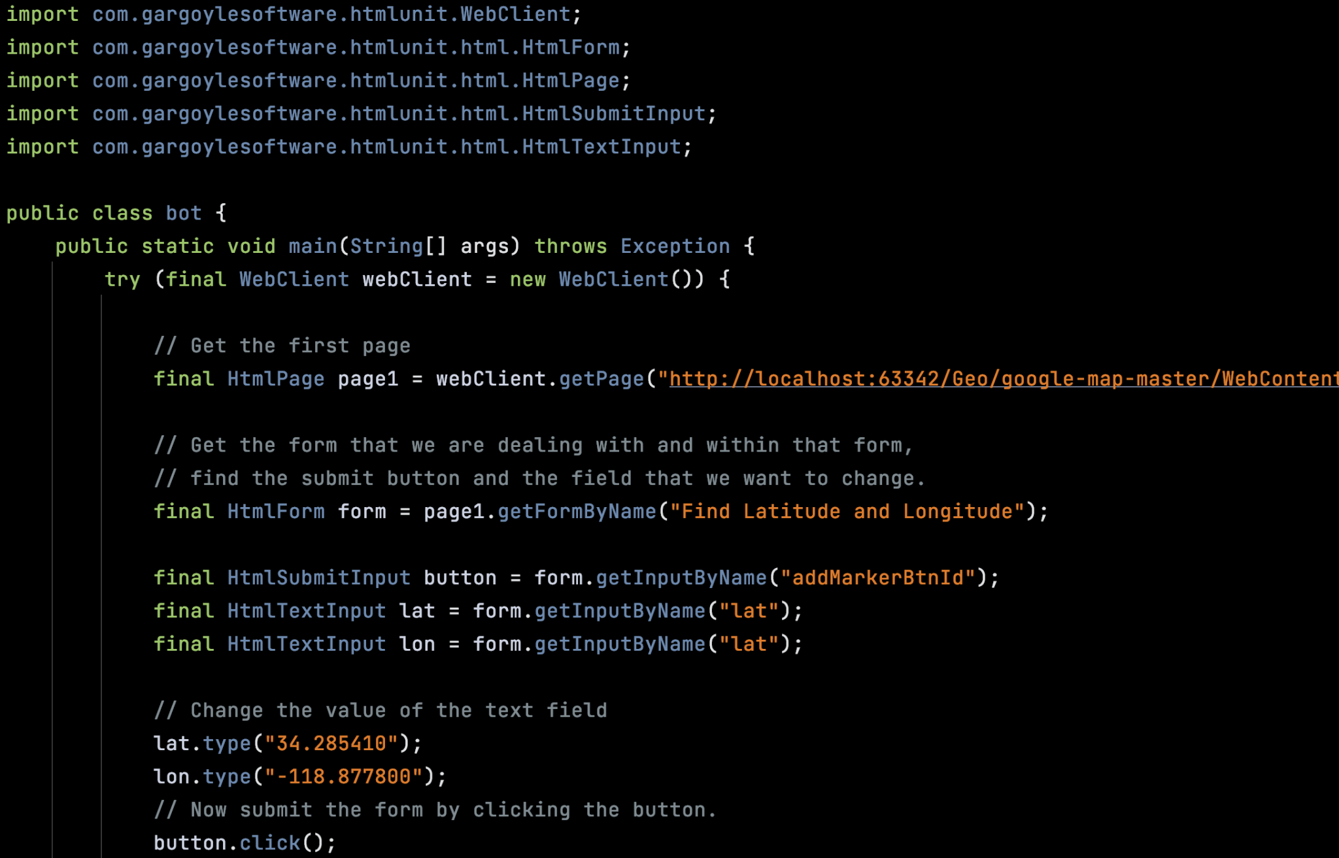
Pushing the Extracted code to the page

